Slide 1
Image Segmentation

Slide 2
Agenda
Segmentation
Color-Based Segmentation
Global Threshold
Intensity slicing
Edge-Based Segmentation
Hough Transform
Edge detection followed by Connected Component

Slide 3
Segmentation

Slide 4
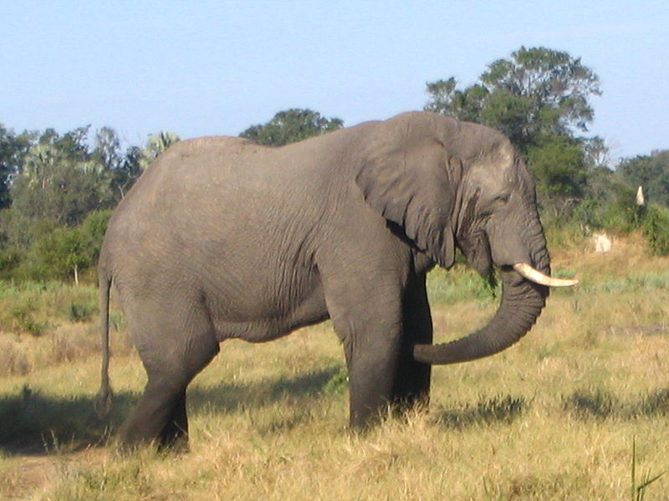
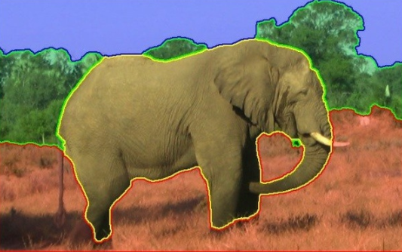
Segmentation?
Segmentation is the process of dividing image into regions such that each region represent a single object.

Slide 5

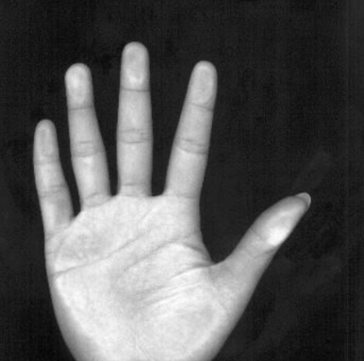
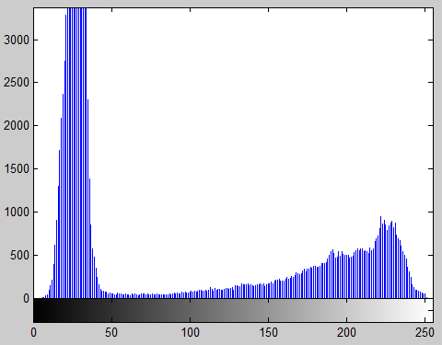
Color-based segmentation (Global Threshold)
Global threshold: simplest form of segmentation
T = 113
Notes:
Global thresholding uses a fixed threshold for all pixels in the image and therefore works only if the intensity histogram of the input image contains neatly separated peaks corresponding to the desired subject(s) and background(s). Hence, it cannot deal with images containing, for example, a strong illumination gradient.

Slide 6

Color-based segmentation (Global Threshold)
Background
Global threshold
Foreground

Slide 7
Demo 1
Open image “b2.jpg” and apply threshold on it to separate the rabbit from the background.
These functions might help:
rgb2gray(X)
imhist(X)
Im2bw(X,thresh)
Notes:
I = imread('b2.jpg');
J = rgb2gray(I);
imshow(J);
imhist(J);
t = graythresh(J);
K = im2bw(J, t);
imshow(K);

Slide 8
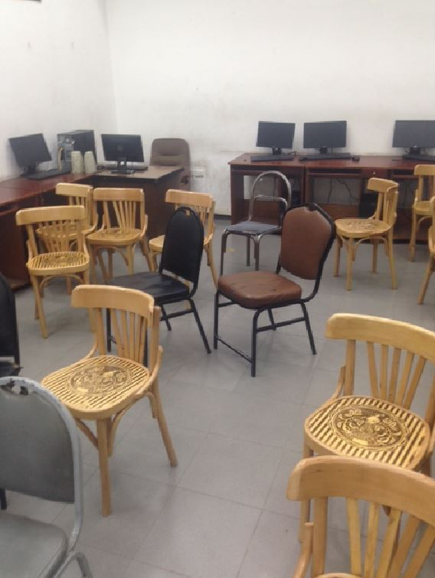
Color-based segmentation (Intensity slicing)
Specific color segmentation:
Extract light brown chairs only?

Slide 9
Color-based segmentation (Intensity slicing)
Specific color segmentation:
R: 210
G: 180
B: 153
R: 151
G: 125
B: 103
R: 109
G: 88
B: 62
Therefore, any pixel that is:
R > 100
R > G by more than 20
G > B by more than 20
Belong to the light brown chair
Notes:
I = imread('2.jpg');
Lightbrown(I);

Slide 10
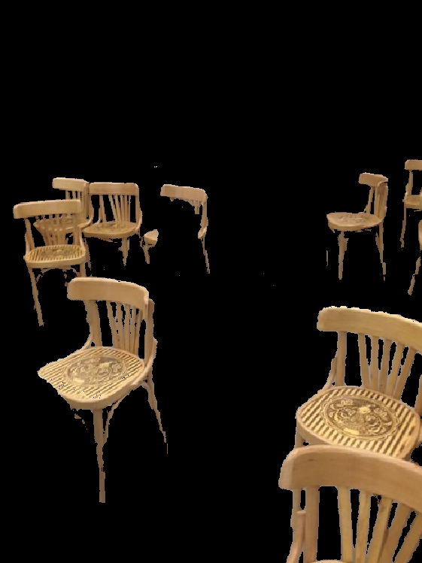
Color-based segmentation (Intensity slicing)
Specific color segmentation:

Slide 11
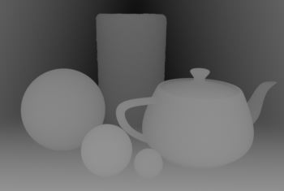
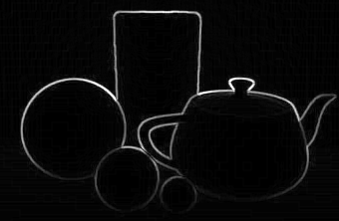
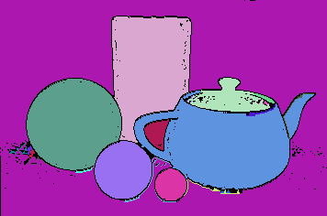
Edge-based segmentation (Edge Detection followed by Connected Components)
Segment based on the object boundaries
Each black region surrounded
By white border represents an object.

Slide 12
Demo 3
Open Image “4.png”
Convert to grayscale
Apply edge detection using “Y = edge(X,'canny’)”
Show the result
If boundaries of each object is not fully connected apply dilation to increase the thickness of edge using
“Z = imdilate(Y,ones(5,5))”
Show the result
Convert image to negative using ~ operator
Show the result
To colorize each group of pixels surrounded by white boundary use
[L num] = bwlabel(Z); %group pixels together
RGB = label2rgb(L); %colorize each group
Show the result
Notes:
Edgebased('4.png');

Slide 13
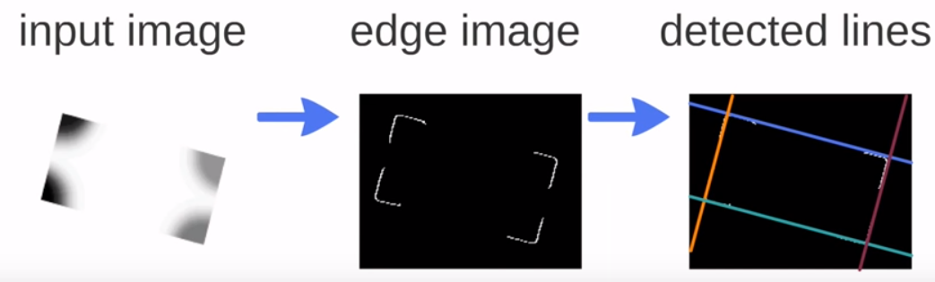
Edge-based segmentation (Hough Transform)
Segment based lines in image

Slide 14
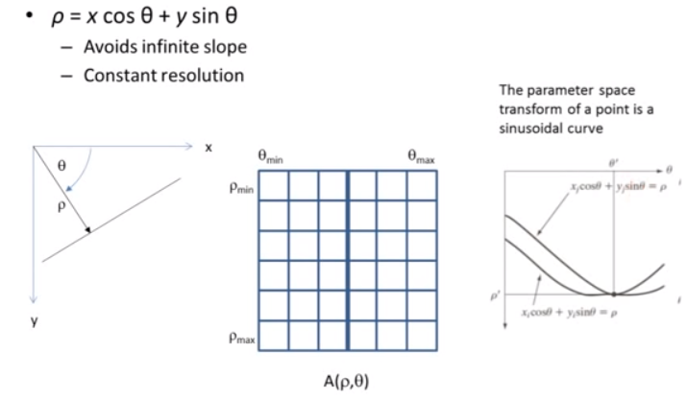
Edge-based segmentation (Hough Transform)
Angle Range: -90~89

Slide 15




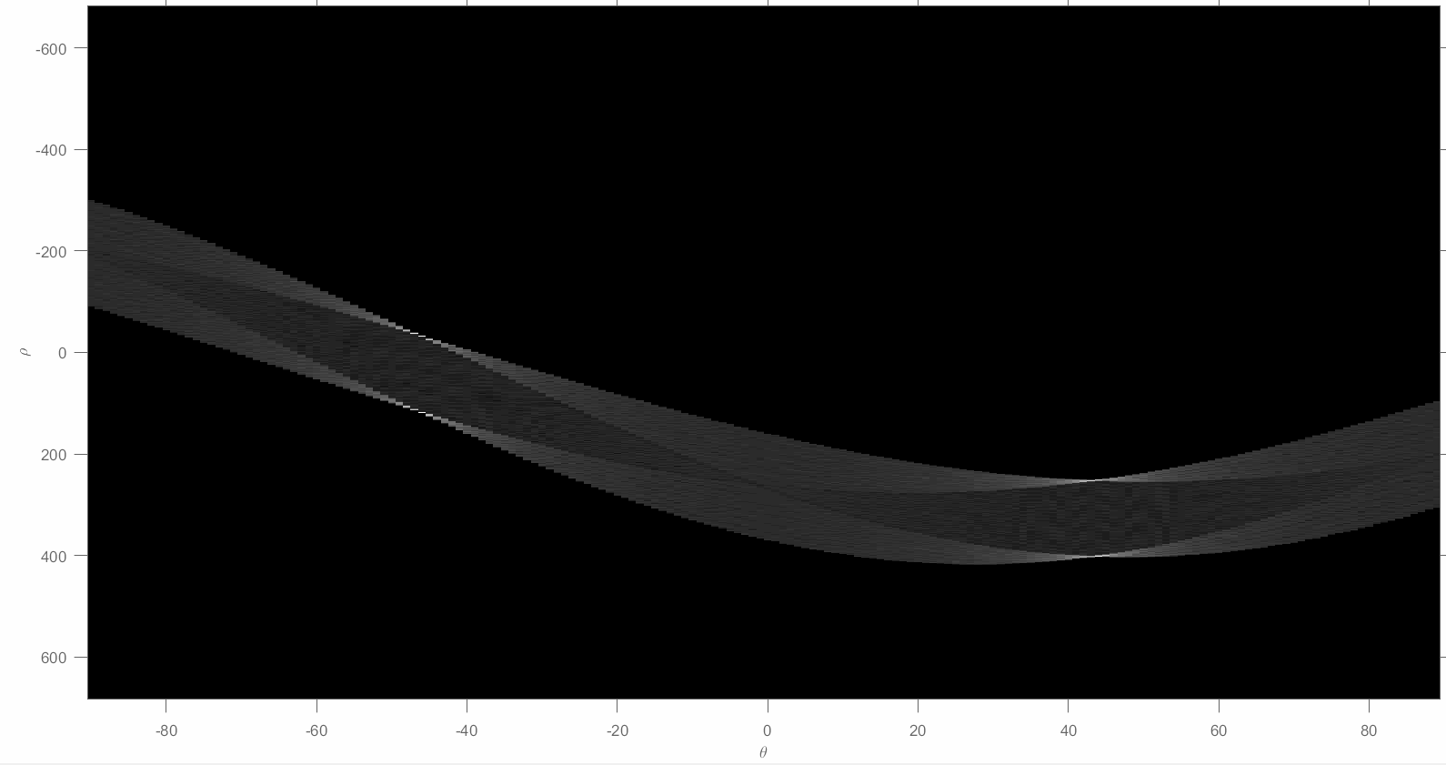
Edge Detection
Hough Transform

Slide 16
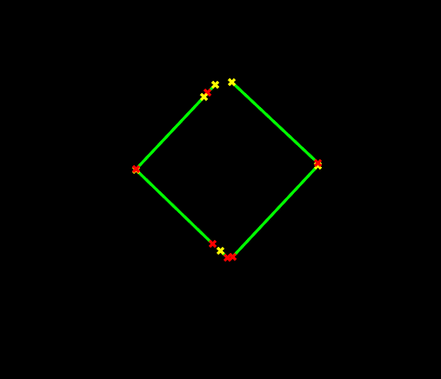
Edge-based segmentation (Hough Transform)
Detected Lines

Slide 17
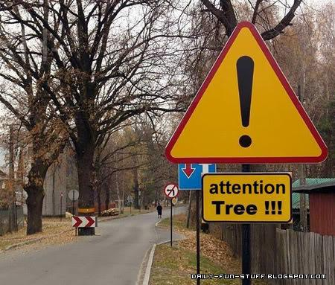
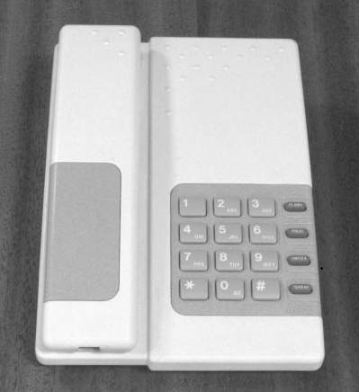
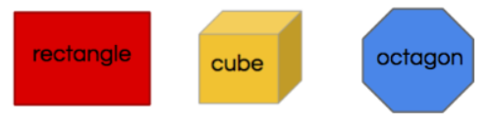
Edge-based segmentation (Hough Transform)
Can be used to segment any object with straight edges
Sign detection
Telephone
Geometric shapes

